Slide 1
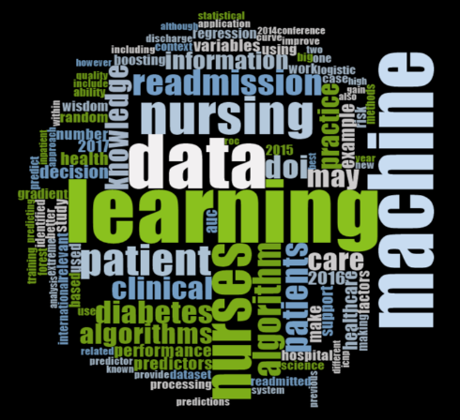

Nurses “Seeing Forest for the Trees” in the Age of Machine Learning
Webinar Series
March 19th, 2020
Jae-Yung Kwon, RN, PhD (c)
Registered Nurse & PhD Candidate, School of Nursing, UBC (sub-specialization in Measurement, Evaluation and Research Methodology, Faculty of Education)
Co-authors:
Ehsan Karim, UBC School of Population and Public Health
Maxim Topaz, Columbia School of Nursing
Leanne Currie, UBC School of Nursing

Slide 2
Outline
Background
Clinician (Nursing) Contribution
Filling data gaps
Improving data preprocessing
Evaluating potential value
Considerations
For researchers and clinicians
Data science and machine learning
Case example
Motivation

Slide 3
Motivation for the study
Machine learning has great potential to provide insights to “big data”
However, the challenge is how to help nurses understand what it is and adopt it in their practice
The key to ensuring that machine learning performs well is to interpret and act on the information given
This requires full participation of nurses (largest healthcare professionals) to maximize the benefits of machine learning
Notes:
We know that machine learning has a lot of potential to make sense of massive, complex data collection that’s happening right but the challenge is how to help nurses understand what it is and adopt it in their practice. And to make machine learning useful, the information derived from machine learning has to be acted upon. And this action requires participation of nurses, who are the largest healthcare professionals, to maximize the benefits of machine learning. And that’s the challenge.

Slide 4
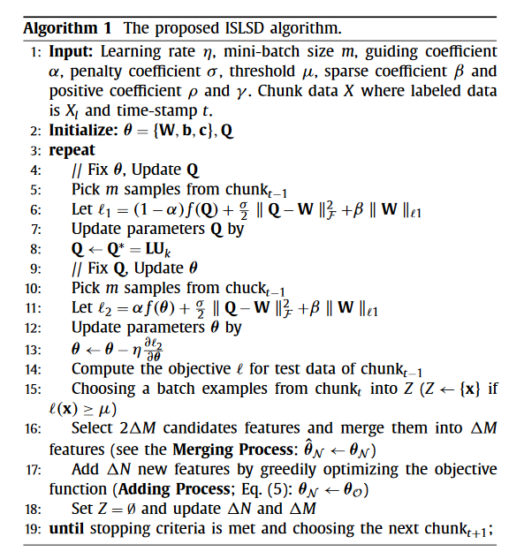
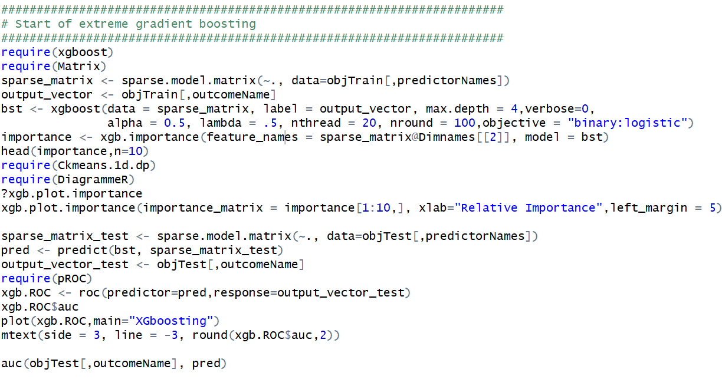
The need for knowledge translation for clinicians…
Notes:
In the machine learning literature, we are creating algorithms and this is how it looks like in computing language. But what are the predictors of an outcome that clinicians would be interested in? Because this is not how clinicians would communicate or understand. So we used the outcome of readmission for patients with diabetes that clinicians would be more familiar with.

Slide 5
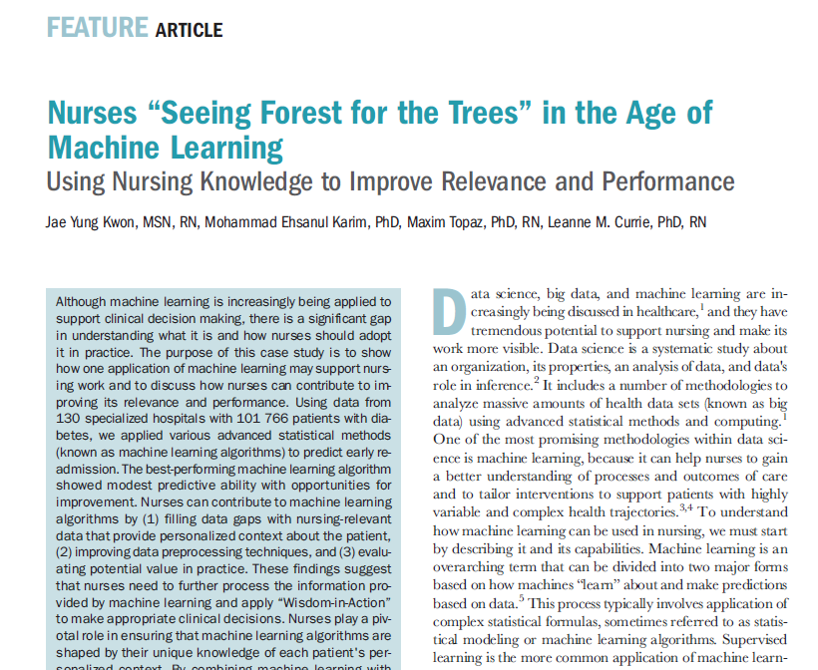
How to reach broader clinical audience?
Notes:
This was the whole basis of our paper: how to reach a broader clinical audience of nurses to help them understand what machine learning is and how to contribute to the relevance and performance of machine learning.

Slide 6
Case example of machine learning
Predicting early hospital readmission (30 days) in patients with Diabetes
Notes:
Use of machine learning to both support clinicians and informed by clinicians.

Slide 7











What is data science?
Notes:
How to make sense of all this data to solve a problem?
An informal definition is how to make sense of all this data inside this data warehouse or central repository to solve a problem. To help solve this problem, data science includes advanced statistical methods and computing called machine learning.

Slide 8



Supervised machine learning using clinical data
Clinical Context
Supervisor
Training Dataset
Desired Output
Algorithm
Predictive output
Data preprocessing (e.g., numbers, text, images)
Feedback loop
Supervised: Machine learns by providing dataset with correct results
Unsupervised: Machine finds structures in the data without being provided with the correct results
Notes:
This figure provides a good framework in machine learning for our study. On the far left is the data warehouse that holds all the data, which goes through preprocessing to make the data understandable for machines, then machine learning algorithm is applied to obtain the predictive output. And the results are fed back to each of these steps to further improve machine learning.
In machine learning there are two general types. First is supervised machine learning where the machine learns by providing dataset with correct results. So if we use our readmission case example, we would provide the machine with those who have already been readmitted vs. those who did not.
The second is unsupervised machine learning where the machine finds structures in the data without being provided with the correct results. So if we again used the readmission case example, the machine would need to figure it out on its own without being provided with the correct results.
Out of the two types, we focused on supervised b/c it’s a more common application to predict readmission outcomes.

Slide 9
Predicting early hospital readmission
Aim
Objective
Examine how machine learning can support nursing work, and to discuss how nurses can contribute
Apply different machine learning algorithms to the same hospital dataset
Notes:
Apply different machine learning algorithms to the same hospital dataset to predict early readmission and evaluate improvement in performance

Slide 10
Methods
Data source
Machine learning algorithms
evaluation criteria

Slide 11
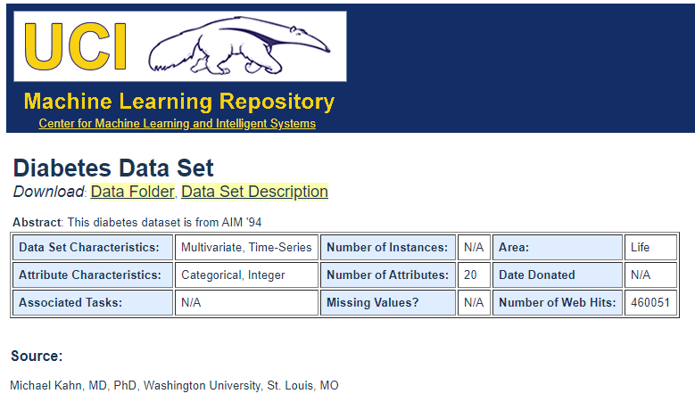
Data source
UCI Machine Learning Repository (https://archive.ics.uci.edu/ml/index.php)
101,766 patients diagnosed with diabetes
Collected over 10 years (1999-2008) from 130 hospitals throughout US
Over 50 clinical variables
Notes:
The data source is from the University of California, Irvine Machine Learning Repository. It has many different datasets so I recommend checking this website for those who are interested. And from this repository, we used the diabetes dataset, which had over 100,000 patients diagnosed with diabetes. The data was collected over 10 years (1999-2008) from 130 hospital throughout United States. And the dataset has over 50 clinical variables including socio-demographics, health-related variables, procedures, and medication data.

Slide 12
Machine learning algorithms
Algorithm | Description
Logistic regression
“Conventional” statistics-based method to predict the relationship between the predictors and a binary dependent variable
Regularized logistic regression (LASSO)
Reduces or “shrinks” coefficients of some variables to zero that removes irrelevant predictors not associated with the outcome.
Random forest
“Ensemble” approach where individual algorithms come together to form better overall algorithm
Extreme gradient boosting
Extends random forest by learning from previously built algorithm to minimize errors learned so far
70% training set & 30% validation set
Notes:
70% training & 30% validation set
Logistic regression is a conventional statistics-based method to predict the relationship between the predictors and a binary dependent variable.
Regularized regression is a modified version to work with very large dataset. It works by reducing or shrinking some variables so that is removes irrelevant predictors not associated with the outcome.
Random forest is a type of ensemble technique where many individual algorithms (weak learners) come together to form a better overall algorithm (strong learner). When I think of random forest I think of one tree branch that is weak and can break easily by itself but when many tree branches come together, it becomes stronger and harder to break.
Extreme gradient boosting extends random forest by being able to learn from previously built algorithms to minimize errors learned so far.
As we go from top to bottom, the machine learning algorithm becomes increasingly more advanced so we would expect extreme gradient boosting to perform the best out of the other algorithms.
A common issue in machine learning is overfitting of the data where it may perform well on the data used during the training but perform poorly on new data, so we randomly divided the dataset into 70% training set and 30% validation set that are typically used in other studies.

Slide 13
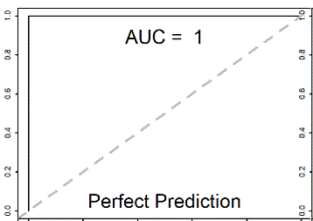
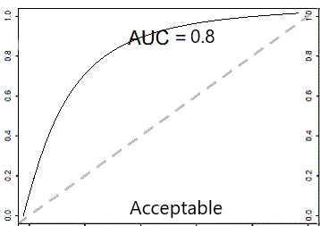
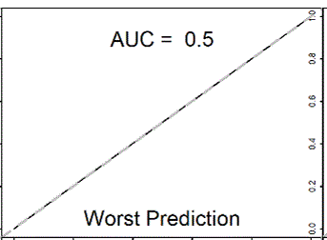
Evaluation criteria: AUC
Notes:
To evaluate the performance of machine learning, we used area under the curve, which is a probability of correctly classifying readmitted as being readmitted, and not readmitted and actually being not readmitted. So AUC of 1 would mean that the algorithm correctly classified all patients who have been readmitted. AUC of 0.5 would mean that algorithm is no better than random guessing. We want the algorithm to be greater than 0.8 to be considered to be have good discriminative ability.

Slide 14
Results
Predictor variables
Top 3 predictors of readmission
Area under the curve

Slide 15
Predictor variables
Variables | Readmitted (n=11,357, 11%) | Not Readmitted (n=90,409, 89%) | P value
Female | 54.2 | 53.7 | 0.36
# of inpatient visits, mean (SD) | 1.2 (2.0) | 0.6 (1.1) | < .001
Discharge disposition Discharged to home Other | 49.3 50.7 | 60.4 39.6 | < .001
# of medications, mean (SD) | 17.0 (8.1) | 16.0 (8.1) | < .001
# of emergency visits, mean (SD) | 0.4 (1.4) | 0.2 (0.9) | < .001
# of diagnosis, mean (SD) | 7.7 (1.8) | 7.4 (2.0) | < .001
# of lab procedures, mean (SD) | 44.2 (19.3) | 43.0 (19.7) | < .001
Notes:
These are sample characteristics table with variables that may be associated with readmission and no readmission. Although we are moving away from reporting p-values in the statistical literature because large enough sample size can make anything significant, p values were reported to get a general sense of the important predictors.

Slide 16
Top 3 predictors of readmission
Logistic Regression |  | LASSO |  | Random Forest |  | Extreme Gradient Boosting
Predictor | Coef | Predictor | Coef | Predictor | Gain | Predictor | Gain
# of inpatient visits | 0.30 | # of inpatient visits | 0.31 | # of inpatient visits | 0.55 | # of inpatient visits | 0.28
Discharge disposition | 0.10 | Discharge disposition | 0.09 | Discharge disposition | 0.20 | Discharge disposition | 0.21
Not taking Tolbutamide | 0.09 | Diagnosis 1, ICD9 V58: Encounter for other procedure | 0.07 | # of emergency visits in the previous year | 0.06 | # of lab procedures | 0.05

Slide 17
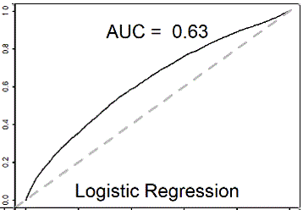
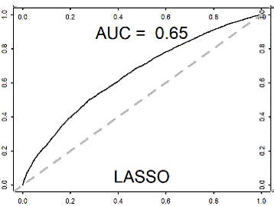
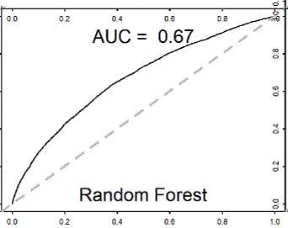
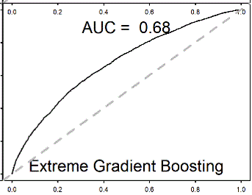
Area under the curve
Notes:
How can we further improve the relevance and performance of these algorithms?
The most sophisticated algorithm did not improve performance much so obvious question was how can we further improve relevance and performance of these algorithms in practice?

Slide 18
Discussion
How can nurses contribute to improving relevance and performance of machine learning?

Slide 19
Supervised Machine Learning using Clinical Data
Clinical Context
1
Supervisor
3
2
Training Dataset
Desired Output
Algorithm
Predictive output
Data preprocessing (e.g., numbers, text, images)
Feedback loop
3 areas for contribution: (1) database (data quality), (2) preprocessing, (3) predictive output
Notes:
3 areas nurses can contribute is 1) database (data quality), 2) data preprocessing steps, 3) evaluation of output.

Slide 20
Nursing contribution #1 Data quality
Filling data gaps with nursing-relevant data that provide personalized context about the patient
“Number of inpatient visits” and “discharge disposition” was identified as strongest predictors of readmission but why?
Category | Nursing Diagnosis
Psychobiological Needs Oxygenation Hydration Sleep Sensory perception Self-care | Dyspnea Edema Insomnia Pain Self-care deficit
Psychosocial Needs Learning | Lack of knowledge of medication Lack of knowledge of disease
Use of standardized terminology that provides patient context
International Classification of Nursing Practice (ICNP)
Other types of data not easily captured or stored
Notes:
What is happening to these patients…No actionable information. There could be # of reasons why patients have frequent inpatient visits.
Consideration of capturing narrative data in paper form (nursing notes) that requires further processing

Slide 21
Nursing contribution #1 Data quality
Ensuring collection of high-quality data
Limitations secondary data sources (vs. primary data sources)
Data collected over 10 years (1999-2008) from 130 hospitals throughout US
Was there onsite audits?
Any training of data collectors?
Was there timely and ongoing feedback about data quality?
Notes:
Analysis of secondary data sources means that researchers are not directly involved in the design and collection of the data so all the nuances regarding the quality of the data will not be known – nurses can provide inside information.
As part of my dissertation research, I spent a few days at each of the sites to understand the work flow and data before undergoing analysis. Need to be cautious of interpreting data without understanding context.
Data quality depends on intended use. If data is intended for clinical decision making– dataset may need to be of highest quality whereas for purely descriptive study– quality may be of lesser importance.
Data quality is deemed a relative concept, defined as the “totality of features and characteristics of a data set that bear on its ability to satisfy the needs that result from the intended use of the data” (Arts et al., 2002, p. 602). Thus, some researchers maintain that the data are of sufficient quality if they satisfy the requirements and needs from the data user’s perspective (Arts et al., 2002; Keller, Korkmaz, Orr, Schroeder, & Shipp, 2017).

Slide 22
Nursing contribution #2 Preprocessing
Improving data preprocessing techniques (cleaning and extracting raw data into understandable format)
Nurses can help identify unique sociodemographic profiles that reflect readmitted patient population
Categorizing age (e.g., older adult population vs “all”-age groups)
Comorbidities (e.g., most commonly associated with diabetes such as heart condition)

Slide 23
Nursing contribution #3 Relevance of predictive output
Evaluating potential value of machine learning in practice
Which algorithm should be implemented in practice?
(1) Are there any biases in the underlying variables?
(2) Does the algorithm perform as expected in practice?
(3) How compatible is the product of machine learning with everyday workflow?
Notes:
To assess type of problems encountered in data collection process and feedback about relevant variables.
Algorithm that performs the best may not be implemented in practice due to myriads of reasons in practice (e.g., difficult to understand algorithm, too many false positives, or based on underlying predictor variables).
Too many false positives (falsely identifying too many readmitted patients) may cause alert fatigue.
Too many false negatives (not identifying high risk patients) may lead to inadequate care and worse patient outcomes.
Machine learning should be evaluated within overall clinical context. Should not be taken at face value but exercising critical thinking, consider tradeoff, and how to improve errors in prediction. For example, variables that could be collected to improve performance from practice.

Slide 24
Concluding comments
Predicting early hospital readmission (30 days) in patients with Diabetes

Slide 25
Key Considerations
Machine Learning
For Researchers
For Clinicians
Data quality issues: “Garbage in, garbage out”
Use of advanced algorithms may not be enough to improve relevance and performance
Both challenges and opportunities
Understanding role of machine learning in clinical context from data collection to clinical decision-making
Share responsibility for meaningful use of machine learning
Be aware of skills and competencies (e.g., improve data quality, use of standardized language, extracting relevant variables)
Notes:
Even the most advanced machine learning algorithm led to slightly improved performance

Slide 26
Thank You !
Questions?
Jae-Yung Kwon, RN, PhD (c)
Registered Nurse & PhD Candidate, School of Nursing, UBC (sub-specialization in Measurement, Evaluation and Research Methodology, Faculty of Education)
jykn@jykngroup.com

